Slide 1
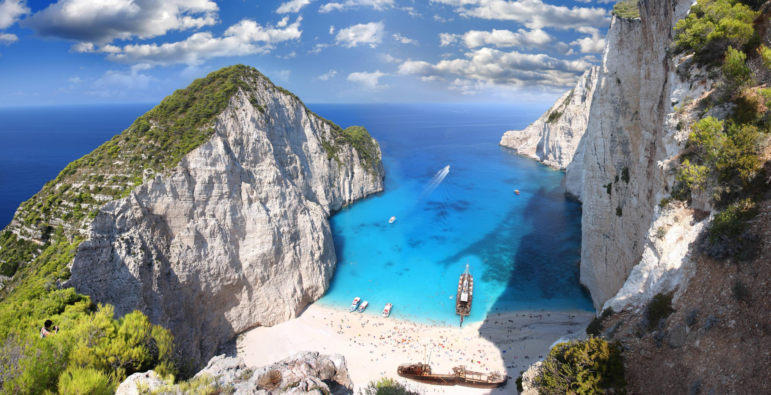
computation
and the brain:
a tutorial

Slide 2
Three parts
Part I: Basic background about the brain
2. Part II: Our formal model and theory
3. Part III: Opportunities for TCS

Slide 3
computation
and the brain:
a tutorial
Part I

Slide 4
Q: Is the brain a computer?

Slide 5

let’s take a poll: please vote!

Slide 6
COMPUTER | THE BRAIN
Inorganic | Alive
Exact | Error prone
100 – 10,000,000 Watts | 20 Watts
Chess, Go, Jeopardy | Survival, creativity, dreams
10¹⁰ ⁻⁻ ¹⁸ operations/s 1 – 40,000 processors | 50 operations/s, 10¹¹ components
Connects to others | If in the mood
Was designed | Has evolved*
Cool machine | Rather emotional
Behavior is deliberately programmed | Behavior is emergent
is the brain
a computer?
the facts

Slide 7
our answer…
the brain is a computer
because if it is not
we will never understand the brain

Slide 8
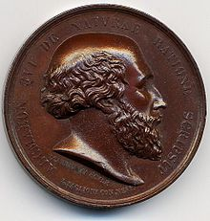
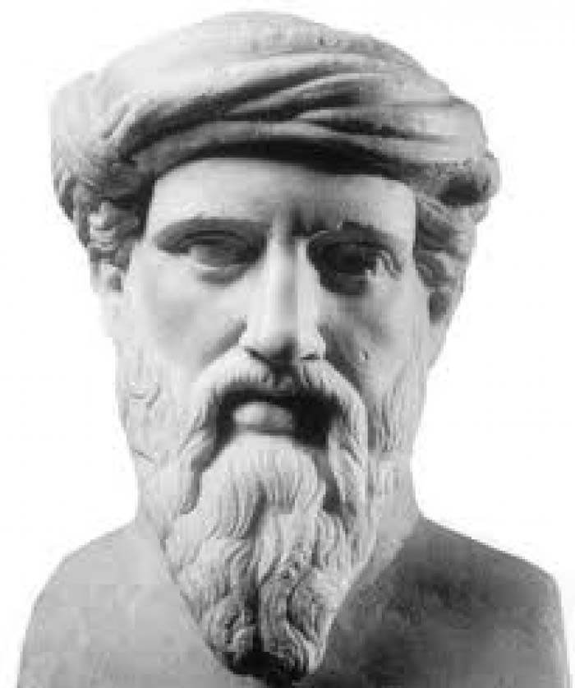
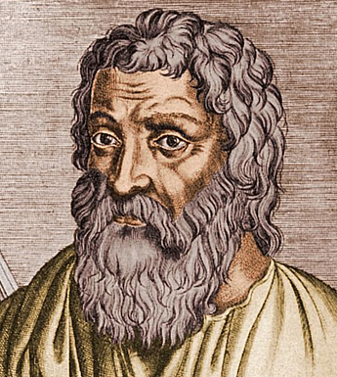
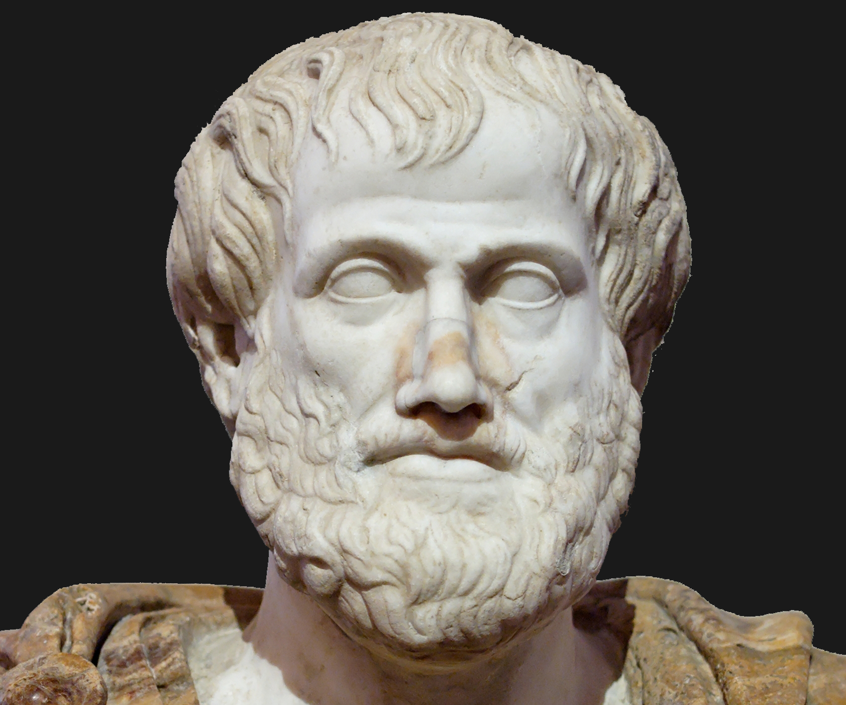
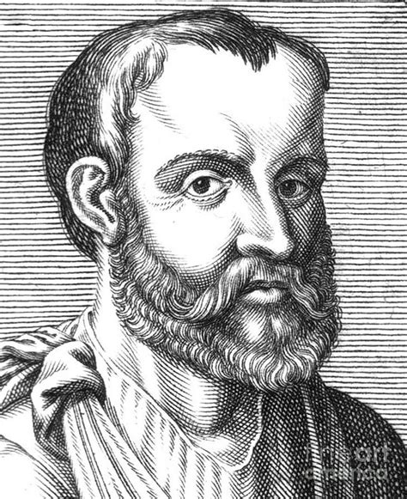
Neuroscience: the origins
Alcmaeon of Croton 520 BC. Pythagoras!
Hippocrates 400 BC
Aristotle 330 BC
Galen 100AD

Slide 9
Neuroscience: the origins
Alcmaeon of Croton 520 BC.
Hippocrates 400 BC
Aristotle 330 BC
Galen 100AD

Slide 11
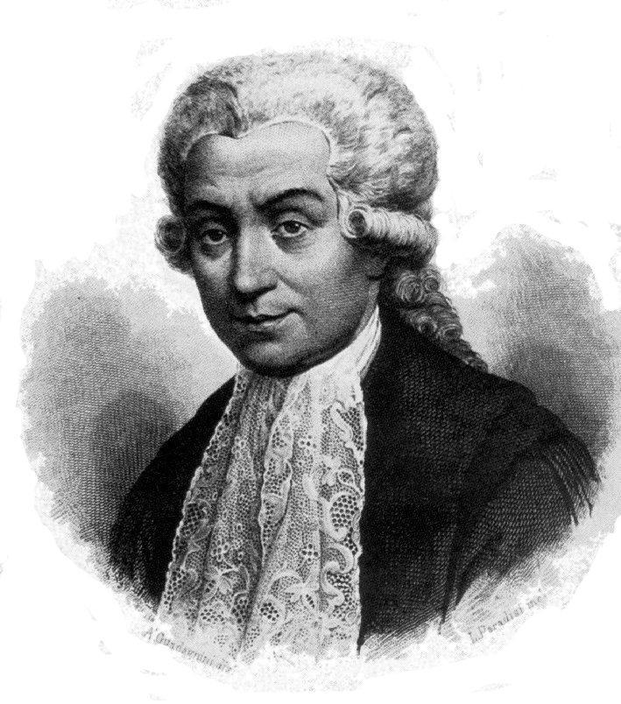
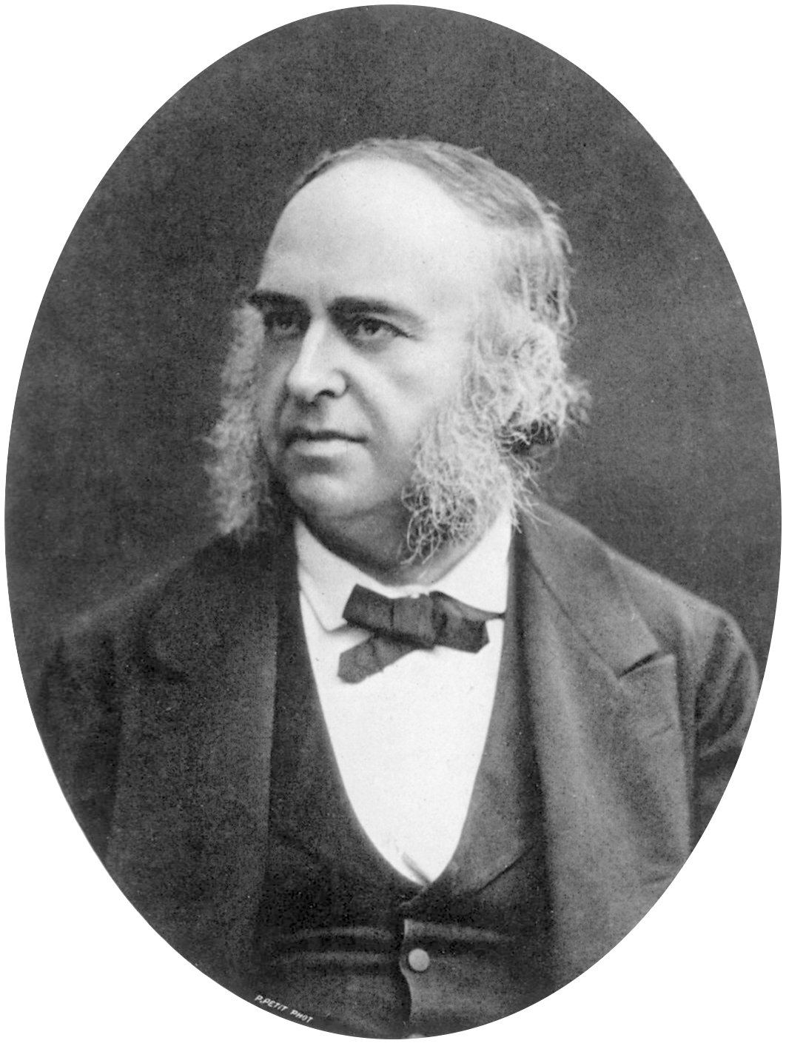
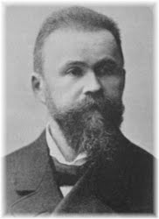
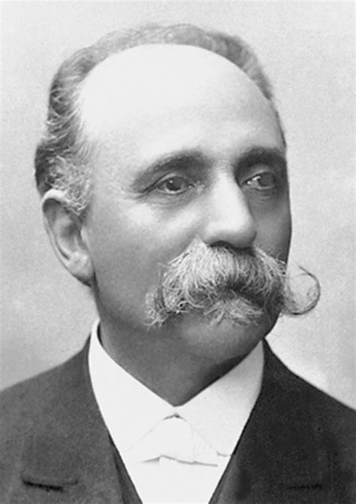
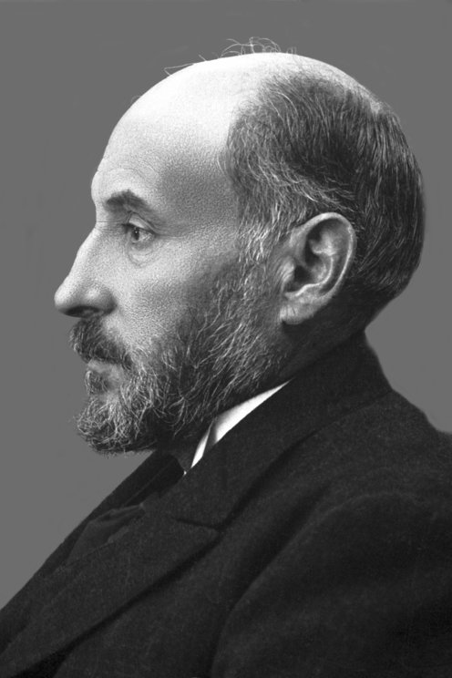
Neuroscience Timeline (cont.)
L. Galvani 1760
P. Broca and C. Wernicke 1870s
Camillo Golgi 1872
Santiago Ramon y Cajal 1880

Slide 12
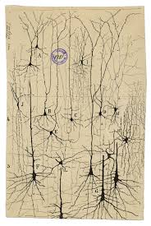
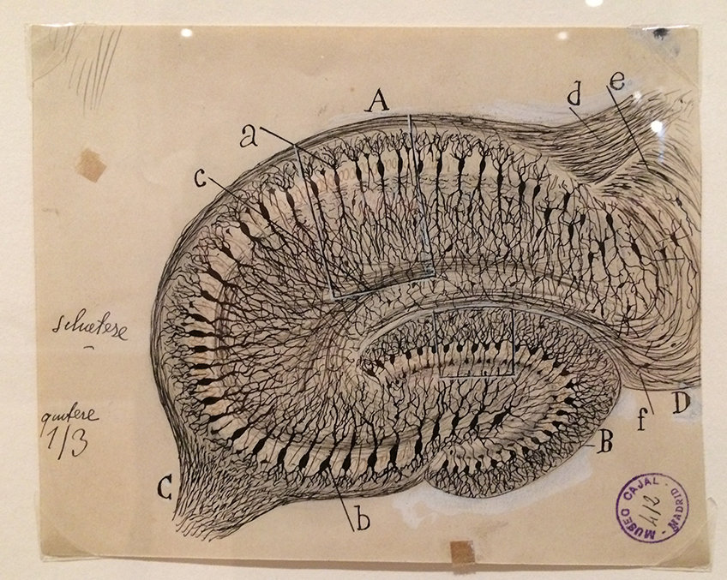
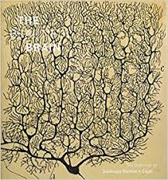
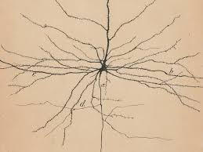
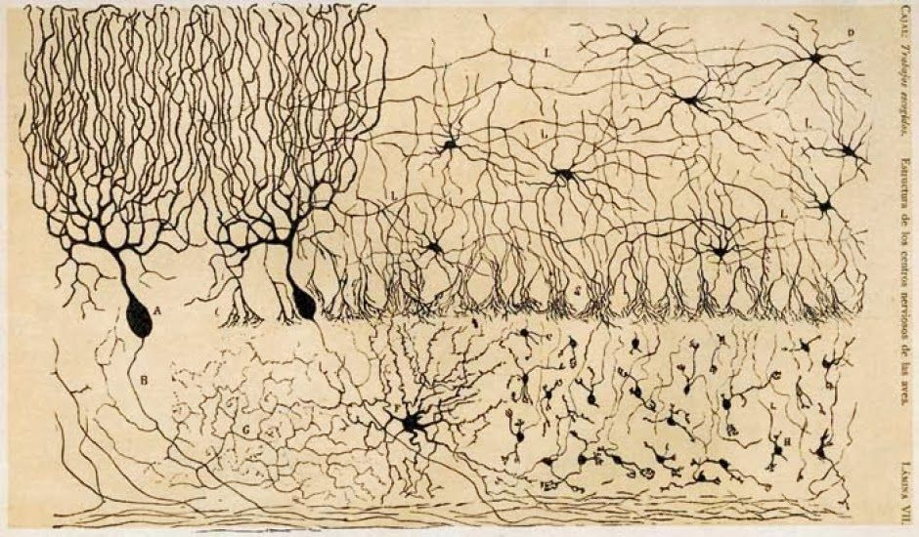
The beautiful brain

Slide 13
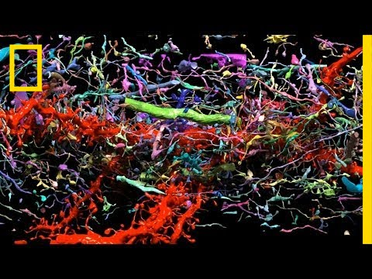
Connectomexplorer
cf: The messy brain
(Jeff Lichtman’s lab ca 2018)

Slide 14
Neuroscience is Born!
C. Golgi and S. Ramon y Cajal
1880 – 1900: The Neuron Doctrine vs Reticulism
1906: The Nobel prize fight

Slide 15
Neuroscience: the Nobels
1906: Ramon y Cajal and Golgi: the neuron
1932: C. Sherrington: the synapse
1936: H. Dale and O. Loewi: neurotransmitters
1963: Eccles, Hodgkin, Huxley: the spike
1967 Granit, Hartline, and Wald; the eye
1970: Katz, von Euler, Axelrod: synaptic vesicles
1981 Sperry, Hubel, and Wiesel: vision
1991: Neher–Sakmann; ion channels
2000: Carlsson, Greengard, Kandel: ion channels
2006: R. Axel and L. Buck: olfaction
2014: O’Keefe, M. Moser, and E. Moser: place cells and grid cells

Slide 16
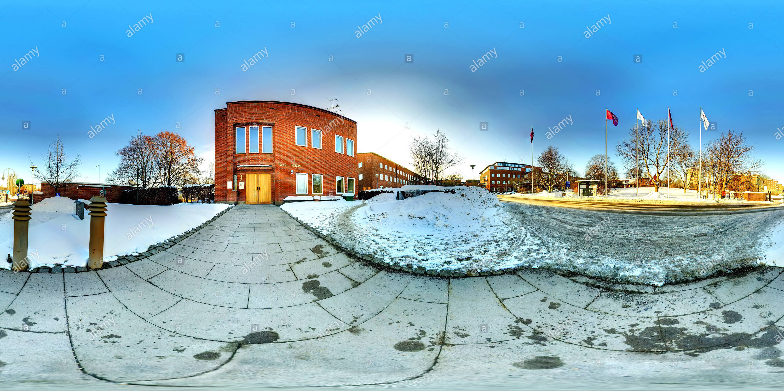
1906 - 2020: The rise of Neuroscience: - the view from Karolinska

Slide 17
brief discussions of the lauded topics
The neuron
Synapses
Neurotransmitters and vesicles
The eye and vision
Spikes and Ion channels
Olfaction
Place cells and grid cells

Slide 18
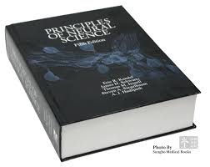

Slide 19
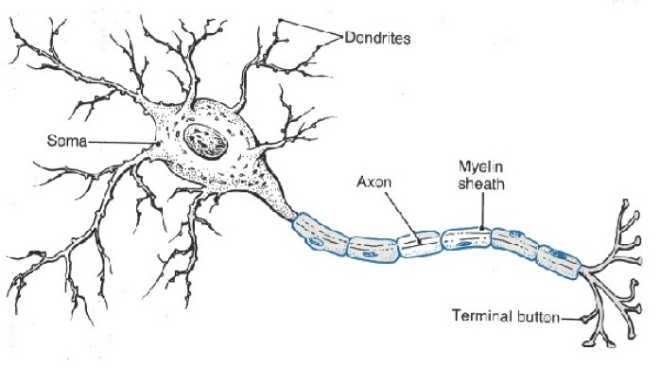
1906: Ramon y Cajal and Golgi: The neuron
soma
dendrite
axon
cone
myeline
boutons and spines
membrane and its potential (-70 mV in steady state)

Slide 20
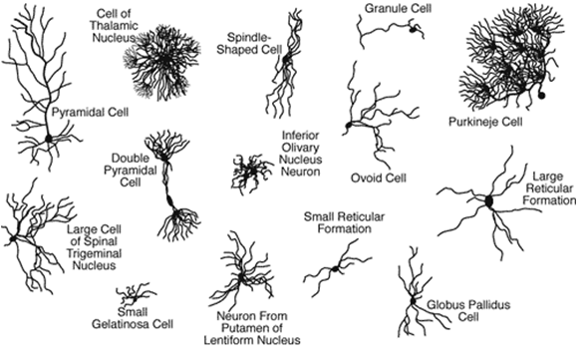
The Neuron
soma
dendrite
axon
myeline
boutons and spines
many kinds

Slide 21
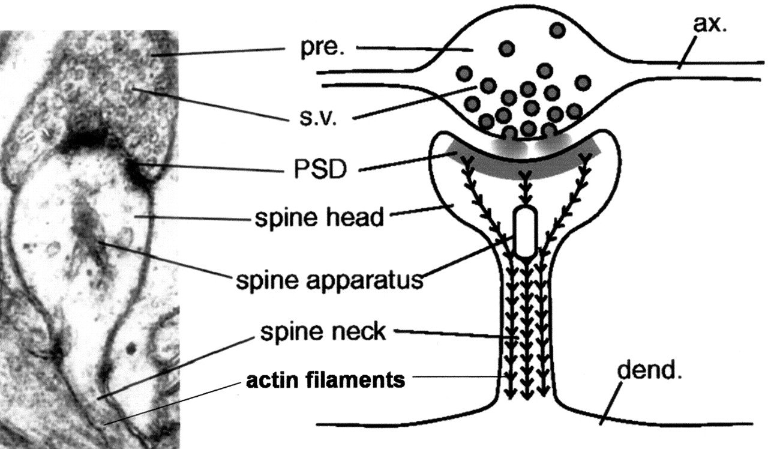
1932: C. Sherrington: the synapse
Bouton
Spine
Cleft
Synaptic weight and its plasticity

Slide 22
Plasticity!
The way brains learn
Synaptic weights change after a firing event
“Fire together wire together” (Hebb)
STDP: precise timing of firing important
Much theoretical and modeling work

Slide 23
Connectomexplorer

Slide 24
1932: C. Sherrington: the synapse
Bouton
Spine
Cleft
Synaptic weight and its plasticity

Slide 25
1936: H. Dale and O. Loewi: neurotransmitters
The chemical language of neurons
The main result of the firing of a neuron is the release of neurotransmitter molecules at the synaptic clefts, and their uptake by the post-synaptic neurons
Some neurotransmitters (Glu, GABA) affect membrane potential and eventually the firing of postsynaptic neurons
Acetylcholine (Ach) mobilizes muscle fibers
Others (dopamine, seratonin, oxytocin) act in more complex ways…

Slide 26
Neurotransmitters: many kinds (from Wikipedia)
Amino acids: glutamate, aspartate, D-serine, γ-aminobutyric acid (GABA), glycine
Gasotransmitters: nitric oxide (NO), carbon monoxide (CO), hydrogen sulfide (H₂S)
Monoamines: dopamine (DA), norepinephrine (noradrenaline; NE, NA), epinephrine (adrenaline), histamine, serotonin (SER, 5-HT)
Trace amines: phenethylamine, N-methylphenethylamine, tyramine, 3-iodothyronamine, octopamine, tryptamine, etc.
Peptides: somatostatin, substance P, cocaine and amphetamine regulated transcript, opioid peptides^{[11]}
Purines: adenosine triphosphate (ATP), adenosine
Others: acetylcholine (ACh), anandamide, etc.

Slide 27
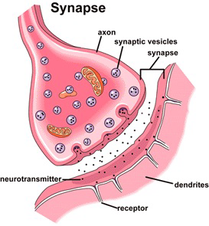
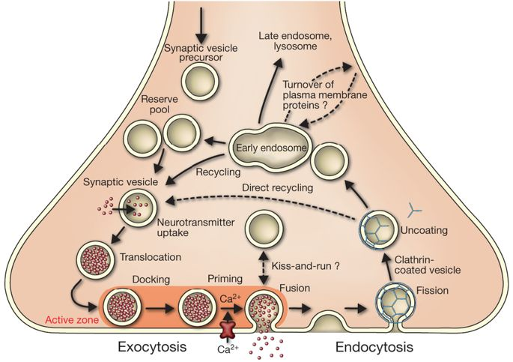
1970: Katz, von Euler, Axelrod: synaptic vesicles

Slide 28
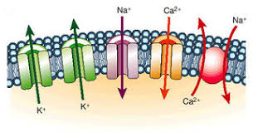
1991: Neher – Sakmann; 2000: Carlsson, Greengard, Kandel: ion channels
Voltage gated, or…
Ligand gated (controlled by other neurotransmitters…)
Glu lets in X⁺: excitatory
GABA lets in X⁻: inhibitory
Ions define the membrane potential of the neuron

Slide 29
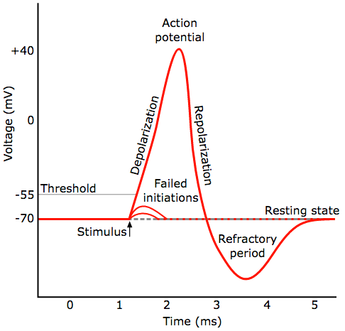
1963: Eccles, Hodgkin, Huxley: the spike

Slide 30
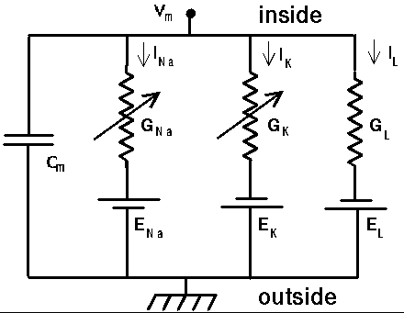
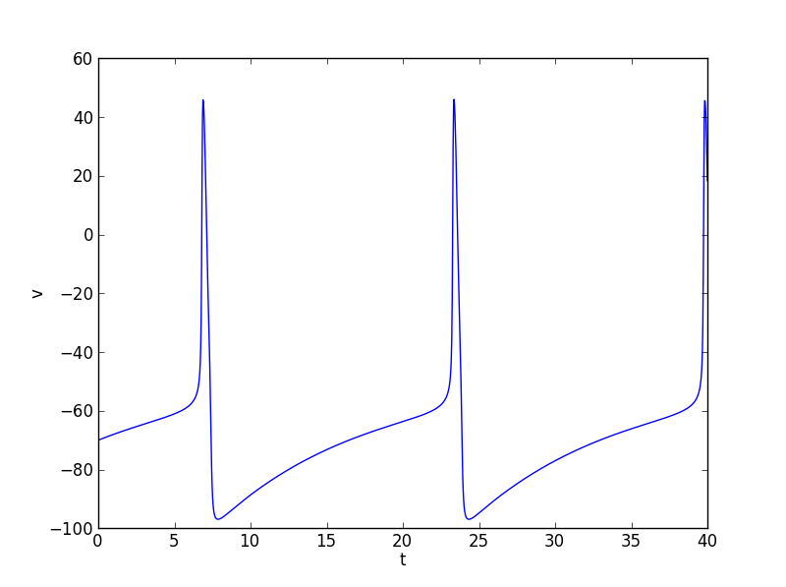
The spike, how?
The Hodgkin-Huxley differential equations (EE version)

Slide 31
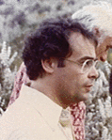
David Marr (1945 – 1980) and the genesis of computational neuroscience The Three-Step Program: -specs -hardware -algorithm

Slide 32
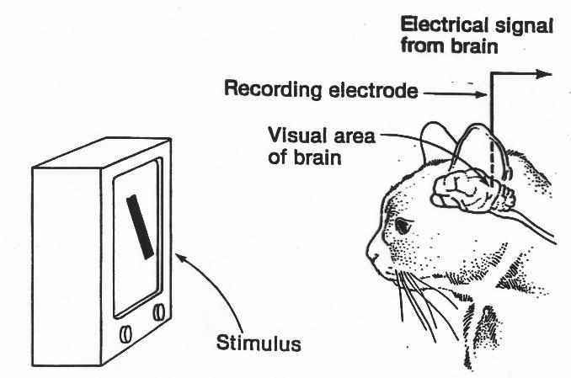
Back to the Laureates: 1981 Sperry, Hubel, and Wiesel: vision
The genesis of the
experimental paradigm…
…and of the quest
for the neural circuit
…and of convolutional
neural nets

Slide 33
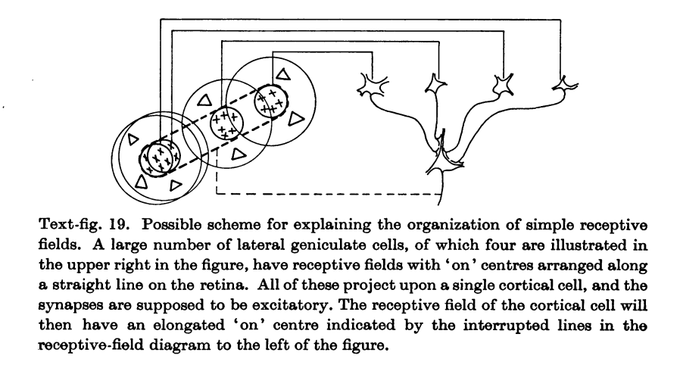
The Hubel – Wiesel conjecture: simple cells

Slide 34
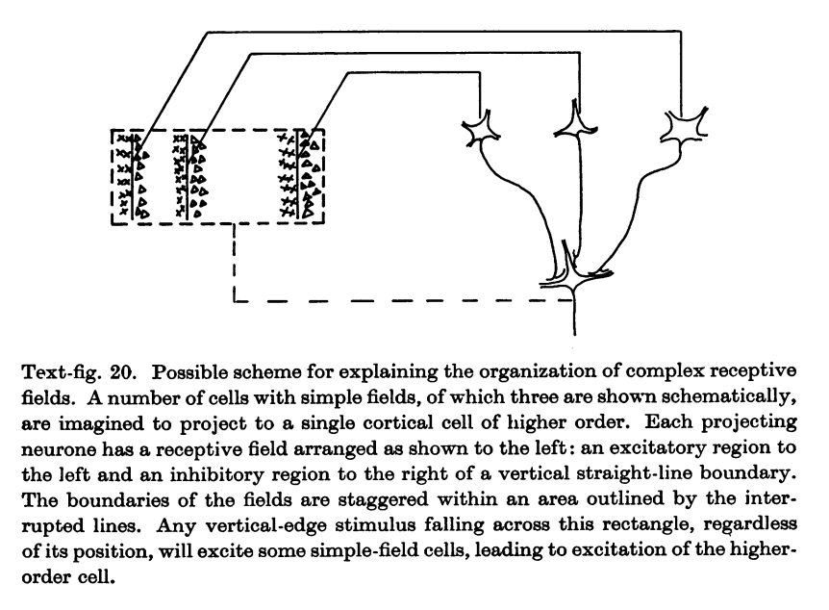
The Hubel – Wiesel conjecture: complex cells

Slide 35
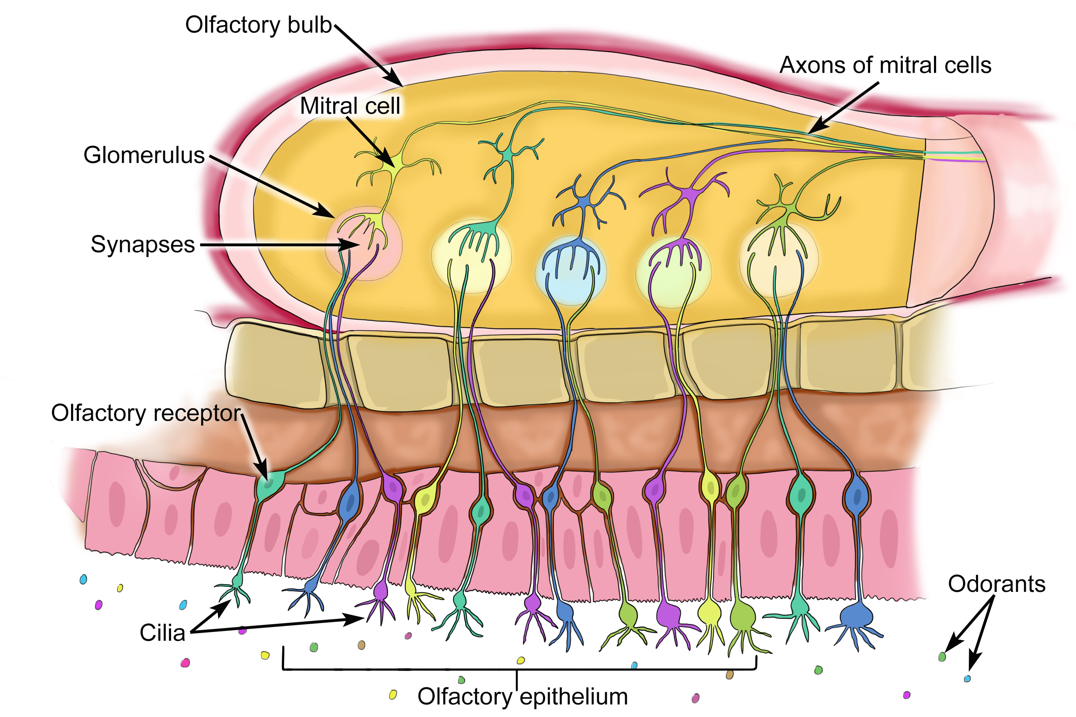
2006: R. Axel and L. Buck: olfaction

Slide 36
The Hubel – Wiesel conjecture: simple cells

Slide 37
The Hubel – Wiesel conjecture: complex cells

Slide 38
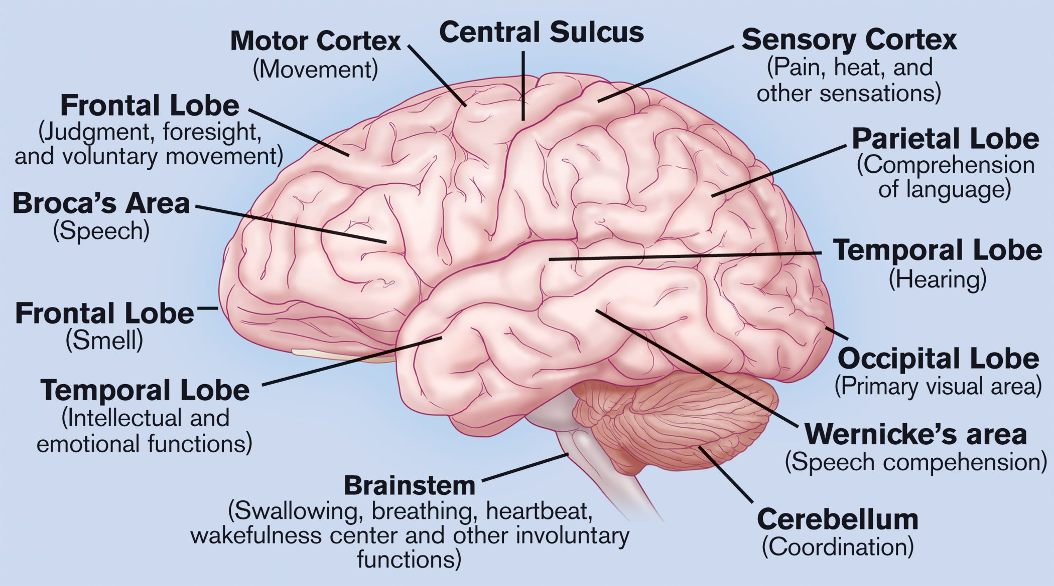
OK, the parts of the brain

Slide 39
Parts of the brain: “a complete list”
Amygdala
Basal Ganglia
Brain stem
Cerebellum
Cerebral Cortex
Corpus collosum
Hippocampus
Hypothalamus
Limbic system
Medula oblongata
Mesencephalon
Optic nerve
Piriform Cortex
Striatum
Thalamus
Vermis

Slide 40
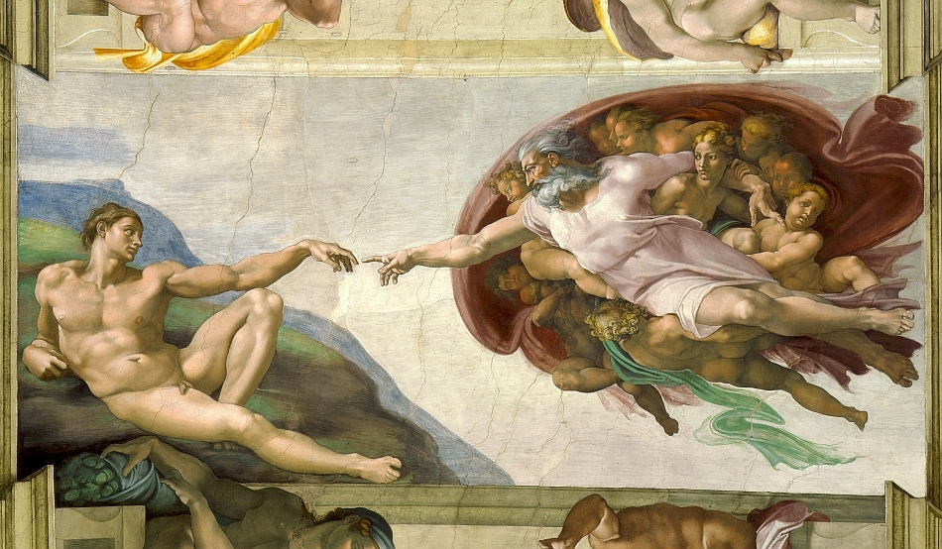
Btw, parts of the brain?

Slide 41
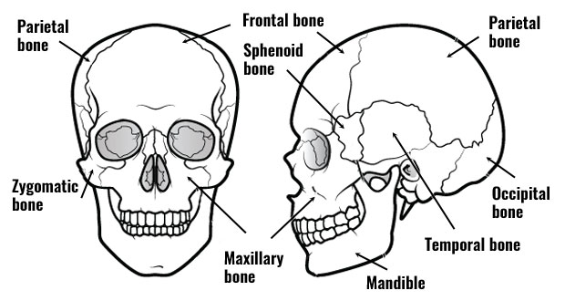
Parts of the brain names: Bones of the skull

Slide 42
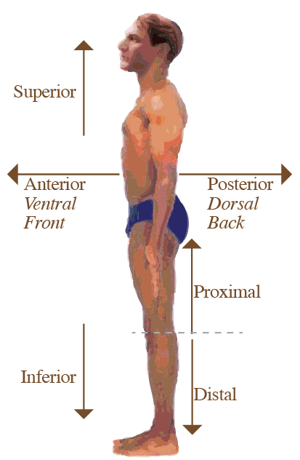
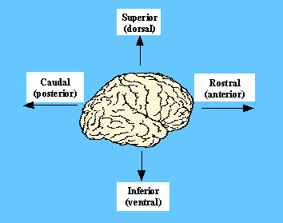
Parts of the brain names: directions

Slide 43
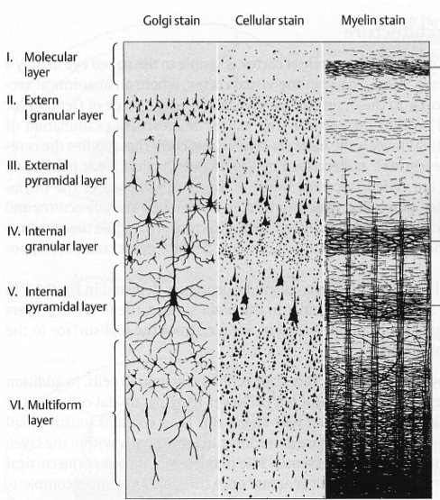
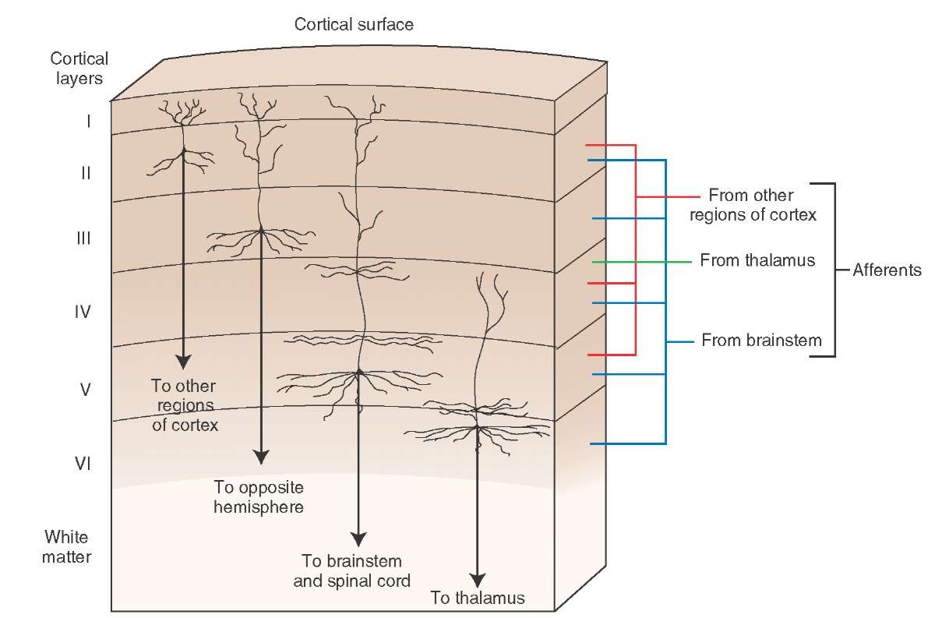
(Cerebral) Cortex: the engine
1.5 mm
2500 cm²
“six” layers
20B neurons

Slide 44
Also: How do they record from the brain?
EEG 1ms 1 cm
fMRI 1sec 1cm
ECoG 1ms 1 neuron (surgical only)
Electrode/electrode arrays very accurate,
Ca+ imaging animals
Optogenetics only

Slide 45
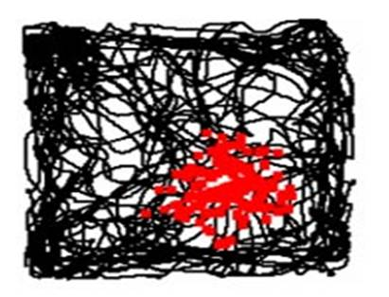
Place cells
Tuning curve of a place cell:
A neuron in the hippocampus that fires when the animal is in a particular place
https://www.youtube.com/watch?v=STyd1qJr3yM

Slide 46
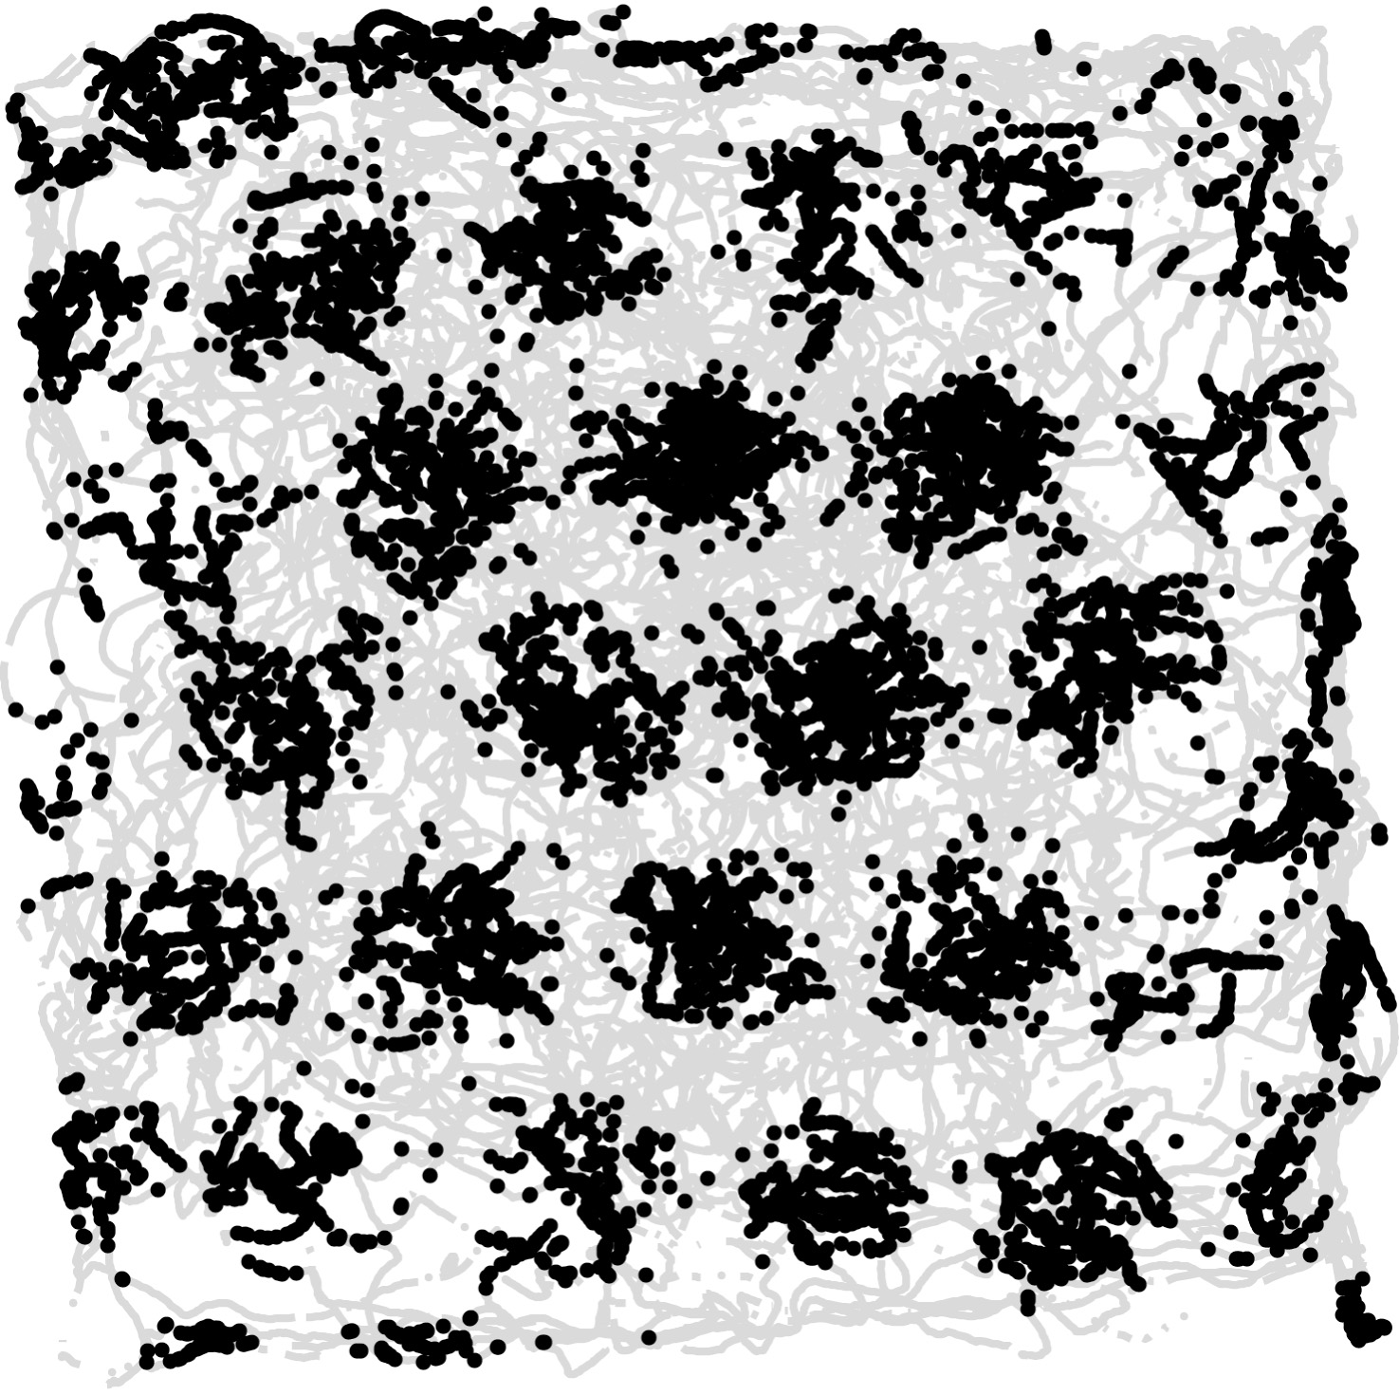
Grid cells
Tuning curve of a grid cell
Grid cell: A neuron in the entorhinal cortex that fires when the animal is in any one of the nodes of a triangular grid (?!)
The movie:
https://www.youtube.com/watch?v=i9GiLBXWAHIons

Slide 47
computation
and the brain:
a tutorial
Part II

Slide 48
How does the Mind emerge from the Brain?
Despite accelerating progress in neuroscience
and increasing insight in cognitive science
an overarching theory remains elusive

Slide 49
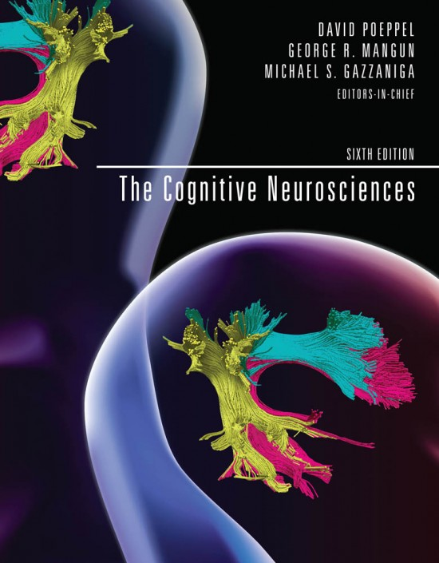
How does the Mind emerge from the Brain? Mind the Gap

Slide 50
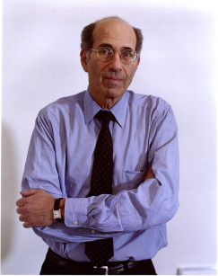
“…we do not have a logic for the transformation of neural activity into thought ... I view discerning [this] logic as the most important future direction of neuroscience…”
Richard Axel, Neuron, Sep 2018

Slide 51
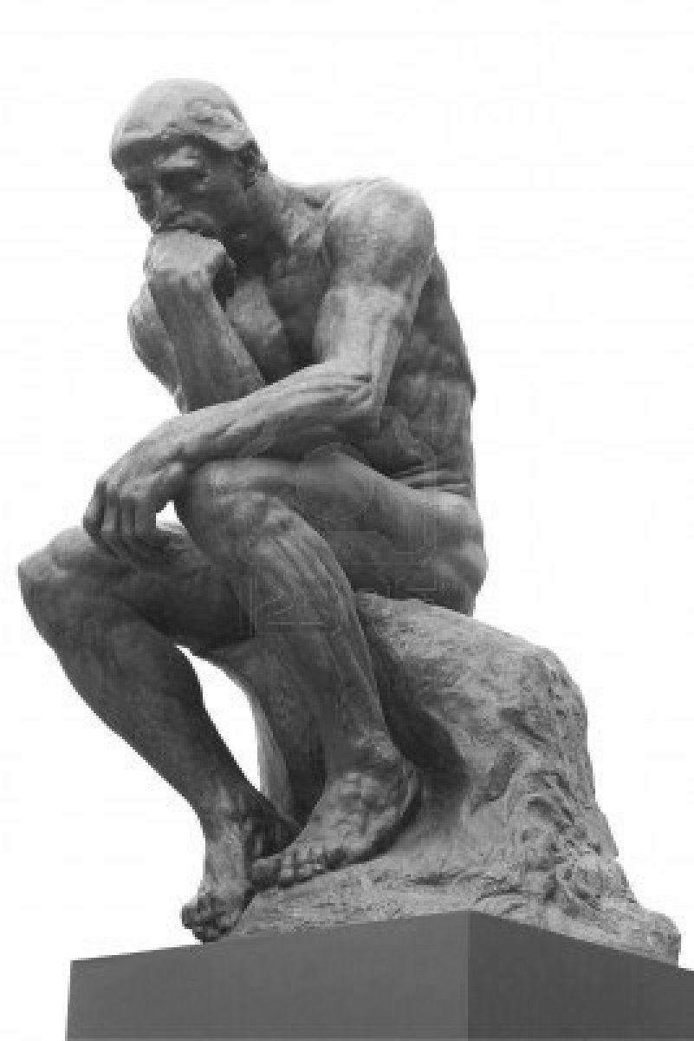
So, what kind of formal theory would qualify as Axel’s “logic”?

Slide 52
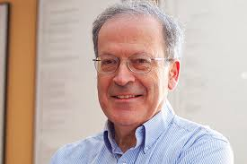
Les Valiant’s theory of neuroids and items [ca 1995]

Slide 53
So, what are we looking for?
a computational system
consistent with current understanding of the brain
explains cognitive phenomena
in the association cortex
(= everything except for sensory and motor cortex)

Slide 54
The rise of the association cortex

Slide 55
So, what are we looking for?
a computational system
consistent with current understanding of the brain
explains cognitive phenomena
in the association cortex
(= everything except for sensory and motor cortex)
what is the basic data type and the basic operations?

Slide 56
Computation in the brain: What is the right level?
Whole brain?
Spiking neurons and synapses?
Dendrites?
Molecules?
?

Slide 57
The Assembly Calculus
A formal probabilistic model of the brain
A basic data type
Basic operations
A completeness theorem (√n space computation)
A killer app (language)

Slide 58
Recent paper
C. Papadimitriou, S. Vempala, D. Mitropolsky, M. Collins, W. Maass “Computation by assemblies of neurons” PNAS, June 2020

Slide 59
A mathematical model of the brain
Finite number of brain regions
Each contains n neurons
Inhibition: only k fire (selection)
Some pairs of areas are
connected by directed B_{n,p}
(= bipartite G_{n,p})
All are recurrently connected
by directed G_{n,p}

Slide 60
The model (cont.)
Neurons fire in discrete steps
The k neurons with highest input
are selected to fire (RP&C)
Connections between areas can
be inhibited/disinhibited
Plasticity: If i→j, i fires and in the
next step j fires, the weight of
i→j is multiplied by (1 + β)
Also: homeostasis, forgetting,…

Slide 61
Main parameters, intended values
n ~ 10⁷
k ~ 10³ ⁻ ⁴
p ~ 0.001
β ~ 0.10
Main ideas: randomness, selection, plasticity
Basic operation: RP&C
online simulator available

Slide 62
OK, how realistic is it?
For a formal model of the brain, very
The discrete steps assumption is certainly not realistic, but we believe that it does not distort behavior
Uses plasticity and assemblies in a rapid time scale
We believe that it is a productive compromise between realism and rigor

Slide 63
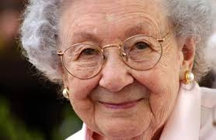
cell

Slide 64
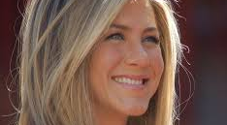
cells

Slide 65
Representation through Assemblies (or ensembles) of neurons
[Hebb 1949, Harris 2003, 2005; Buzsaki 2008, 2010, Yuste et al. 2019,…]
Assembly: A large and densely intraconnected set of excitatory neurons in a brain area whose firing (in a pattern) is tantamount to our thinking of a particular memory, concept, person, name, word, episode, etc.
G. Buzsaki 2020: “assemblies are the alphabet of the brain”

Slide 66
The assembly hypothesis
There is an intermediate level of brain computation
Call it the Assembly Calculus
It is implicated in higher cognitive functions such as reasoning, planning, language, story-telling, math, music, …
Assemblies of neurons are its basic representation – its “data type”

Slide 67
The assembly hypothesis
There is an intermediate level of brain computation
Call it the Assembly Calculus
It is implicated in higher cognitive functions such as reasoning, planning, language, story-telling, math, music, …
Assemblies of neurons are its basic representation – its “data type”

Slide 68
The assembly hypothesis (cont.)
What are the operations of the Assembly Calculus?
Projection
Association
Pattern completion
Merge
Bind (or reciprocal projection)
...plus a couple of control commands

Slide 69
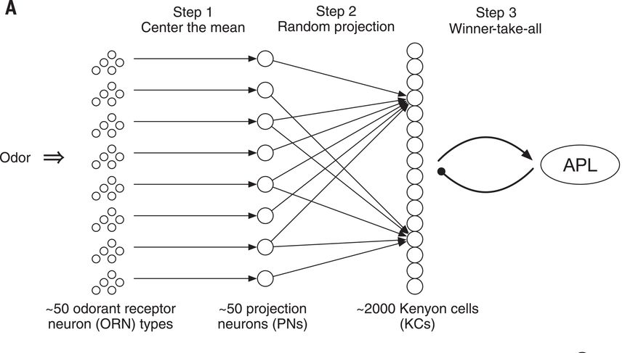
Projection: How fruit flies remember smells
random
projection
followed by cap (RP&C):
k=100 winners
(out of n=2000)
take all

Slide 70
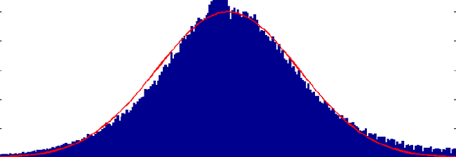
RP&C: a basic operation in brain computation
k

Slide 71
Projection: How fruit flies remember smells
Q: but wait a minute! Is this
a random
bipartite
graph?

Slide 72

YES! ”Random convergence of olfactory input in the Drosophila mushroom body” by S. Caron, V. Ruta, L. Abbott, R. Axel,2013
Bottom line:
looks like a random bipartite graph,
except that the degree distribution
of the LHS is not uniform

Slide 73
RP&C: overlap preservation
A set A of k out of n nodes of the LHS fire
A new set cap(A) is formed by RP&C
Repeat now for B, cap(B)
If A and B overlap in 𝛂k nodes, what is the
overlap of cap(A) and cap(B)?

Slide 74
RC&P: some math
Theorem [2018]: The intersection of cap(A) and cap(B) will be, with high probability, at least
$$\frac{{\left(\frac{k}{n}\right)}^{\frac{1−α}{1+α}}}{{\left(\ln{n/k}\right)}^{\frac{α}{1+α}}}$$
Conjecture:
no denominator

Slide 75

overlap preservation: compare with simulations

Slide 76

So much for the fruit fly…
Q: Does something homologous
happen in mammals?
A: Yes, except that now there is recurrent connectivity in the target area, as well as plasticity…

Slide 77
Projection of an assembly: (RP&C)*
Assembly
Also, Hebbian
plasticity

Slide 78
Theorem (P., Vempala 2016-18): The projection process converges exponentially fast, with high probability, and the total number of cells involved is at most:
If β ≥ β*: k + o(k)
If 0< β < β*: k⋅exp(0.17⋅ln(n/k)/ β)
β* = (√2 -1)/(1 + √pk/ln n)

Slide 79
Projection convergence theorem: proof highlights

Slide 80


k = 100

Slide 81
Second operation: Association of two assemblies
assembly
representations
two
stimuli

Slide 82

The [Ison et al. 2016] experiment

Slide 83
The [Ison et al. 2016] experiment

Slide 84
The [Ison et al. 2016] experiment

Slide 85


Slide 86


Slide 88


Slide 89


Slide 93
The assembly operations
Projection
Association
Pattern completion
Merge
Binding or reciprocal projection
...plus a couple of control commands

Slide 94
Merge of assemblies: it’s complicated…

Slide 95

Merge: How does language happen?
Wernicke’s area
Broca’s area

Slide 96
But why study Language?
A last-minute adaptation
It evolved to exploit the brain’s strengths
Invaluable lens for studying the brain
A deluge of recent experiments!

Slide 97
The [Poeppel 2016] experiment
fret
ship
hill
give
true
melt
fans
blue
guess
hits
then
cats
4 hertz

Slide 98
The [Poeppel 2016] experiment, stage II
bad
cats
eat
fish
new
plan
gave
joy
little
boy
kicks
ball
1 2 4 hertz

Slide 99
My interpretation
bad
cats
eat
fish
new
plan
gave
joy
little
boy
kicks
ball
1 2 4 hertz

Slide 100
How are these tree representations created? in about a dozen spikes per step? (Why a dozen? neuron spikes ~ 50Hz : language ~ 4Hz)

Slide 101
[Frankland & Greene PNAS 2015]
“The ball hit the truck”
vs
“The truck hit the ball’’
Different areas of the Superior Temporal Gyrus (STG) responded to “truck” in the two sentences
The first area also responded to
“The truck was hit by the ball”

Slide 102
Zaccarella & Friedericci “Merge in the human Brain” Front. Psych. 2015
The completion of phrases, and especially of sentences, activates parts of Broca’s area

Slide 103
The Language Organ
Broca’s
area
Wernicke’s
area
Lexicon

Slide 104

Merge: Does it need enhanced hardware? (The mystery of the Arcuate Fasciculus)

Slide 105
Assembly Calculus recap
project(y, B, x)
associate(x, y)
pattern_complete(x, y)
merge(x, y, B, z)
Plus: activate(x), read(), disinhibit(A)
Q: How powerful is this system?
A: can perform arbitrary √n-space computations

Slide 106


Finally: a brain architecture for syntax
S
VP
boy
kick
ball
boy
kick
ball

Slide 107
Assemblies help explain how to construct a sentence scaffold
Comprehension: same mechanism – plus on-line parsing, ambiguity resolution, …
Production (without articulation) may be much more ancient
Planning, deduction, story-telling may use the same merge apparatus and pathways
The mystery of the S-V-O word orders
S
V
O

Slide 108
The SVO map of languages…
SOV: 45% Japanese, Urdu, Latin, Ancient Greek, Korean, Sanskrit,…
SVO: 42% Chinese, English, Hebrew, Greek, German, Spanish, Thai,…
VSO: 9% Biblical Hebrew, Arabic, Welsh, Filipino,…
VOS: 3% Malagasy, Car,…
OVS: 1% Apalai,…
OSV: 0.01% Warao

Slide 109
Explanation?
[Diel 1975], [Mallinson and Blake 1981], [Krupa 1982], [Tomlin 1986], … Various systems of linguistic principles; S-V-O orders are sorted in decreasing degree of compliance with these principles
[Manning and Parker 1989, 1991] “Semantic diagram”
[Maurits 2011, 2014] SVO frequencies are the steady state distribution of a Markov chain. Languages evolve, word orders change, and one can estimate the transition rates

Slide 110
S-V-O word orders: a computational explanation
Recall that syntax tree
Articulation Strategy: selecting a permutation of the three leaves
How is an AS implemented?
S
V
O

Slide 111
AS implementation through lock an unlock
An internal node may lock a child (when it fires)
A leaf may unlock another leaf (again, when it fires)
Eg, S-O-V
Note: this already explains why SOV, SVO >> others
S
V
O

Slide 112
S-V-O word orders: a computational explanation
Assume f(𝝿) ~ exp(-complexity(𝝿))
Complexity = sum of ”costs” of lock and unlock steps
Gradient descent → values for unlock costs between leaves (assuming unit cost for locks)
Prediction: OV ~ VO, SV >> VS
S
V
O

Slide 113
computation
and the brain:
a tutorial
Part III

Slide 114
Part III: A Few Research Directions
Research directions related to the Assembly Calculus
Random graph models of the connectome
Sparsification
Learning without GD
Learning with RP&C
Robustness

Slide 115

Assembly Calculus: Assemblies and Convergence
Assembly support size. Is there a phase transition in the support size of an assembly from $ω(k)$ to $k+o(k)$ as the plasticity parameter $β$ increases?
Assembly convergence. For high plasticity and with high probability, the limit of the random project plus cap process is a single fixed subset of size $k$. What are other possible limiting behaviors? E.g., is it possible to get two subsets of size $k$ (possibly overlapping) that fire alternately? (We know cases where this happens at a small scale, that is, the two subsets of size $k$ differ in a few cells.) Will the limit have a common core (of what size as a function of plasticity) that always fires? Is the limit an activity pattern of finite length/description?

Slide 116

Convergence on Graphs
Process:
We begin with k random vertices firing
Repeat:
Each vertex gets weight equal to the edge-weighted sum of firing vertices
Highest k fire.
Does this process converge?
On $G_{n,p}$ we need plasticity.
What graph structure would lead the above process to a fixed point, even with no plasticity?
Conjecture: Geometric random graphs

Slide 117


Convergence on Geometric Random Graphs (with Mirabel Reid)
Vertices are random points in a square, n = 10,000, k=100.
Edge probability is proportional to $e^{−{\left\|x−y\right\|}^{2}/2σ^{2}}$, edge density = 0.01.

Slide 118

Assembly Calculus: Assemblies and Computation
Model. Can our results be extended to less stylized models in which neurons fire asynchronously, or there is explicit inhibition (instead of cap)?
Base graph. We have assumed the base graph to have independently chosen edges. What is a deterministic condition on the base graph that suffices? E.g., is it enough to have expansion and roughly uniform degrees? Is global expansion necessary or do sufficiently strong local properties suffice (e.g., degree and co-degree)?
Extending GNP. Are richer models, e.g., those with higher reciprocity or triangle density, useful? For example, do they enable more powerful or efficient computations? (more on this shortly…)
Computational power. Show that randomized $s(n)$ space bounded computation can be simulated with $n$ neurons and $O(1)$ brain areas for some function $s(n)$ larger than $\sqrt{n}$.
Capacity. Suppose that, in a brain area, we want to maintain with high probability pairwise intersections: two assemblies that intersect in a large $α$ or more, say) fraction of their support should continue to so intersect, and similarly for pairs that intersect in less than $α$ fraction. For how many assemblies can we guarantee this invariant, as a function of $n$?

Slide 119
UNDER CONSTRUCTION

Slide 120

Random Graph models
$G_{n,p}$ with sufficient plasticity and edge density leads to stable assemblies and supports assembly operations
The connectome shows noticeable deviations from $G_{n,p}$, e.g., in the number of triangles and other small subgraphs
What deviations would be helpful? How to model them?!

Slide 121


Nonrandom features of Connectome
[Song et al 2005]: reciprocity and triangle completion
G_{n,p}
p ~ 10⁻²
G_{n,p}++
p ~ 10⁻¹

Slide 122

Capturing edge and triangle density
Impossible for any stochastic block model unless the number of blocks grows with graph size!
0.1 0.2 $d$
0.6
0.1
Proof: #k-cycles $≤ rank(M).d^{k}$

Slide 123

Approach 1: Random Overlapping Communities
To create a graph on n vertices with edge density p
Repeat $pn^{2}/qs^{2}$ times:
Pick random subset of s vertices
Add random graph of density q on these vertices
Thm [Petti-V.18] For any $d=O\left(n^{1/3}\right)$, almost any feasible edge density, triangle density and 4-cycle density can be simultaneously achieved by a ROC model.
Research question: how to generate a random graph with desired densities of a given set of fixed graphs?

Slide 124

Random Overlapping Communities (ROC)
A graph is built by taking the union of many relatively dense random subgraphs.
Thm.[Petti-V. 2017] Any realizable clustering coefficient and degree distribution can be approximated by a ROC random graph.
Higher degree vertices are in fewer triangles

Slide 125

Approach 2: Geometric Random Graphs
Vertices are assigned values in an interval or region (could be higher dimensional).
Edge probability depends on distance between endpoints.
Does this model have an advantage over $G_{n,p}$?
Empirically, YES: Assembly projection appears to be more efficient with geometric random graphs!

Slide 126

Sparsification
It is well-known that many synapses in the brain are pruned in the first two years of life.
Assume pruning is also Hebbian, i.e., it is a function of activation sequences at end points.
Research Question. Starting with $G_{n,p}$, what is a Hebbian process that results in higher triangle (and small motif) densities?

Slide 127
Learning
Does the brain do GD?
A topic of debate, with little convincing evidence.
Can synaptic plasticity lead to effective learning?
Could plasticity based learning have advantages over GD?

Slide 128
The problem with plasticity
Each update is local
This might be OK for the last layer
since the output is set to the correct label, synapses get useful feedback
But what about lower layers? How do they get feedback on how to modify weights?

Slide 129
A Brain-inspired NN: Recurrent Neural Net
No layers, just a single sparse, random directed graph
Top k fire
For T rounds
Input connects to this graph
Graph connects to output
How to train?
GD with one sample at a time
Hebbian plasticity

Slide 130


Simple RNN
GD seems to work, i.e., high accuracy on some benchmarks
but is not bio-plausible
What about synaptic plasticity? Can that be used?
In principle, YES!
Each neuron now has an activation sequence of length T (number of rounds).
How to choose/design a plasticity rule?
Idea: use GD to find a good plasticity rule!
Rule for updating a synapse $(i,j)$ depends on activation(s) at $i,j$ and whether the output of the current network matches the true label, i.e,
$$R=R(a_{i}, a_{j}, err)$$

Slide 131


Brain-inspired NN: the landscape of Synaptic Plasticity Rules
$r:{\left\{0,1\right\}}^{T}×{\left\{0,1\right\}}^{T}×\{0,1\}→R$ (graph) $r:{\left\{0,1\right\}}^{T}×\left\{0,1\right\}→R$ (output)
Use GD to minimize Loss
Loss(r): Loss after updating network weights with rule r for N steps.
Q. Why should there exist effective plasticity rules?
Perceptron and Multiplicative weights updates are (output) plasticity rules!
Q. Can they be discovered automatically?
Thm. 1 [Cristian-Dabagia-PV20] Optimizing the output layer synaptic rule with cross-entropy loss is a convex optimization problem.
Moreover,
Thm. 2 [CDPV20]. GD on an additive output rule, from any starting rule, and network weights initialized to zero, converges to a rule with sign pattern $[−,+;+,−]$.

Slide 132

Learned Plasticity Rules Generalize!
Will rules learned on one data set generalize to other completely different ones?
(learn a set of weights, you can classify cats; learn a rule, you can classify anything)
Yes! Rules learned on small, simple data sets work well on new (larger) models and completely different data sets
Using a graph (RNN) rule gives a small, consistent boost in performance.

Slide 133
Learned Plasticity Rules
Research question: Are RNN plasticity rules provably effective?
Note: we used two forms of plasticity rules
a full table based on activation patterns at endpoints
a small auxiliary NN that takes the activation sequences as input and outputs the change to the synapse weight
Assemblies and Clustering. Does the assembly process map examples from sufficiently separated clusters of data to different assemblies, so that stimuli from the same cluster share a large core of neurons?

Slide 134
Robustness
The brain appears to be amazingly robust in its function
It learns concepts from a few examples
And effectively de-noises a variety of data
Deep Learning in contrast is famously brittle to adversarial examples
??

Slide 135

Robustness of RP&C
Is k-cap more robust? Does it avoid “vanishing gradients”?
Yes, empirically! [Xiao-Zhong-Zheng2020]
Research question: Show that RP&C converges to stable assemblies even when each k-cap is noisy.

Slide 136



Robustness to adversarial examples
(Recall: take correctly classified example; distort minimally, using GD, to induce classifier to output wrong label)
Compare GD based linear classifier with plasticity rule base classifier:
Can you guess which is which?!

Slide 137

Plasticity-trained classifiers are more noise resistant!

Slide 138


Does Plasticity engender Adversarial Robustness?
Each example perturbed till it is at $ε$ distance or gets a different label.
Research question: Is plasticity based training better than GD for adversarial robustness?

Slide 139
So…
Understanding the Brain raises fascinating …
Thank you!

